Slide 1
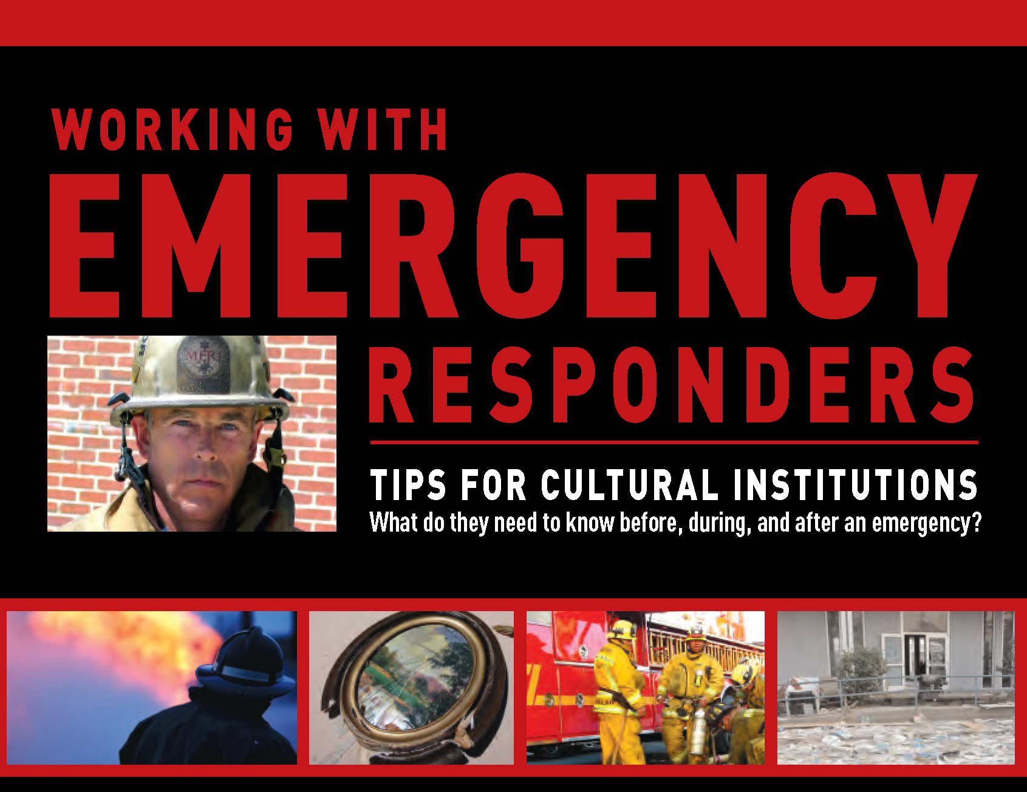
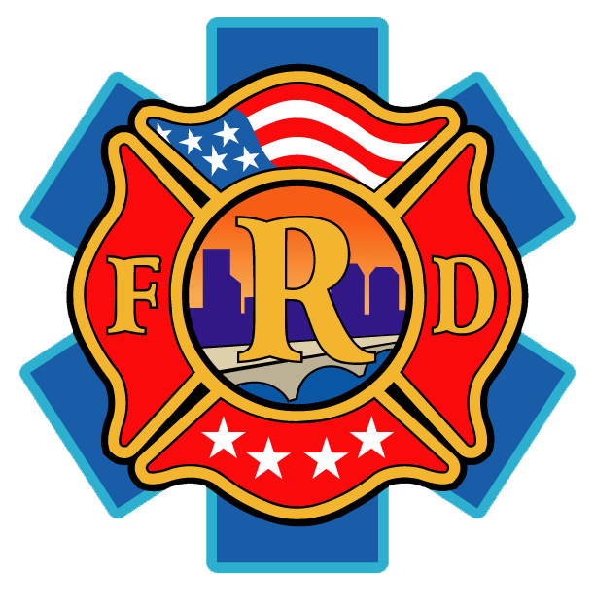

Slide 2
Fire
No institution is immune from fire.
Flood damage can be dried out and restored, stolen property has a chance of being recovered; damage from fire is usually permanent and irreparable.
Fire is more cunning and less discriminating than a thief.
It can spread through very small areas quickly.
Cavalier attitude “fire won’t happen to me”.
Blind faith in local fire department to save them and their property.

Slide 3
Planning
Without a plan to deal with the threat of fire, you place the buildings, occupants, visitors and collections at risk.
Complexity of these plans may vary from simple to more complex.
The first few minutes in a fire incident is critical.
Planning, training, and automatic fire protection systems are key ingredients to protection.
Should have an emergency self-protection plan that spells out how to report a fire and safely evacuate the premises.

Slide 4
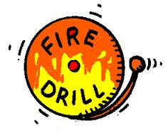
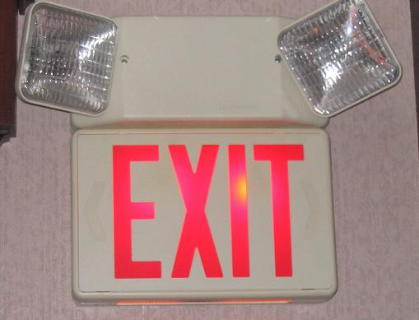
Life Safety
Life must always be priority number one.
Instruct employees on how to turn in an alarm:
Make sure they know what the building fire alarm sounds like.
Ensure employees can hear the alarm.
Ensure all employees know their primary and secondary exit routes.
Exit doors are accessible, unlocked and not blocked.
Exit signs are operating and visible.
Emergency lights are functional and adequate.
Ensure the staff knows where the meeting point is outside the building.

Slide 5
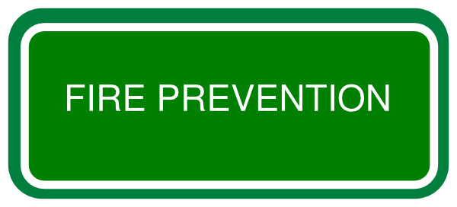
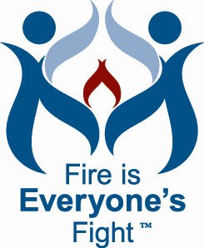
Most important factor in preventing a fire loss is maintenance.
The fire protection policy needs to be in writing and updated periodically.
Management and staff responsibilities need to be defined and fire prevention procedures established.
This program needs to be based on a high standard.

Slide 6
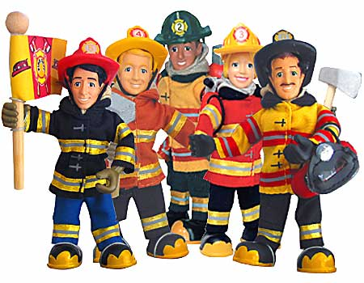
Expectations of Fire Department
Understand fire departments seldom respond to your types of property.
How fast can they get to your location?
What is the ISO rating of your fire department?
Has the fire department pre-planned your facility?
Have you shared your emergency plan?
Does the fire department know what is valuable?
Have you collectively discussed what is needed to protect your valuables?
Does the fire department need special equipment or additional personnel to best protect your valuables?

Slide 7
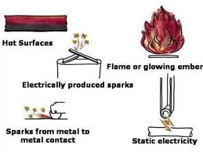
Safeguarding Ignition Sources
Much can be done to minimize chance of a fire starting or spreading with little, or no expenditure of monies.
Your elementary school training taught you that it takes fuel, air and heat for a fire to occur.
You can’t do much about air, but you can control both the
fuel and ignition sources in your facilities.
Leading causes of fire include heating devices, cooking,
electrical wiring, appliances and smoking.

Slide 8
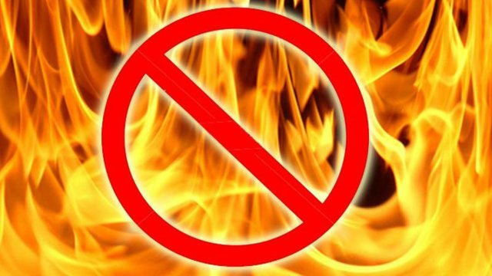
Reducing the Likelihood of Fire
Welding, cutting and burning.
Fuel fired portable heaters should be prohibited.
Electrical appliances should be restricted and kept away from combustibles.
Heating, air conditioning and other mechanical equipment should be installed by professionals in compliance with codes.
Electrical wiring should be installed in strict accordance with code.
Consider installing arc-fault circuit interrupters on your electrical circuits.
Lightning protection should be checked by an expert to ensure that it is adequate, in good repair and properly grounded.

Slide 9
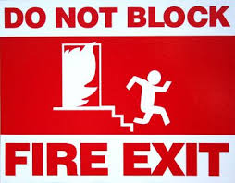
Safeguarding Fuel Sources
Safe containers should be used for collecting waste papers, oily rags, and other refuse including packing materials.
Store important papers or collections in fire resistive safes.
Hallways, stairways and access aisles must be kept clear of all storage.
Storage should be prohibited in mechanical equipment rooms,
electrical closets and within 3 feet of the front of electrical panels.
Exhibits , interior/exterior modifications, should be constructed of fire
safe materials to reduce the fire risk. Use fire retardant material.
Treat combustible materials with a fire retardant chemical or paint reduce the chance of ignition.

Slide 10
Passive Fire Protection Measures
Proper disaster planning should consider all active fire systems failing.
Consider how you can further incorporate vertical and horizontal barriers to resist fire spread. Maintain their integrity.
Fire doors protect opening in fire walls and should not be propped open, that they positively latch and they close without assistance.
Make sure penetrations for duct work, electrical wiring and plumbing in fire-rated walls, floors and ceilings are sealed.
Placement of collections into enclosed cabinets and containers is a form of compartmentation that is highly desirable.

Slide 11
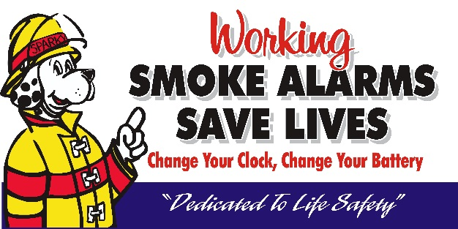
Fire Detection Systems
Historical buildings often present unique fire detection and suppression issues.
What is the purpose of the fire detection system?
Strictly life safety (local alarm)
Sound an alarm and summon trained personnel
Heat detectors – slow to react due to the need for heat buildup.
Smoke detectors – best early detection of fire; placement is key
Photoelectric detectors – provide special coverage; not for every facility.

Slide 12
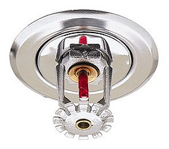
Fire Suppression Systems
Portable fire extinguishers
Requires human reaction and risks
Fire sprinkler systems
Wet, dry and pre-action systems
Not just building protection but designed for life safety
Proven reliability
Reduce water damage resulting from fire fighting operations
Gaseous fire suppression systems
Clean agent
Need enclosed area
Limited amount of agent
Require regular maintenance
Do not protect the building structure

Slide 13
Summary:
Evaluating your facility needs is very important.
Developing an emergency plan, training employees
and working with the local fire department is key to prevention and actions in case of an emergency situation.
Identifying valuables and how to protect them should be a part of every emergency plan. Simply thinking someone will remove items from the facility may not be feasible or warranted.

