Slide 1
Models for Building Local Response Networks
Tom Clareson
Senior Consultant for Digital & Preservation Services, LYRASIS
Mississippi Gulf Coast Alliance for Response Forum
April 27, 2016

Slide 2
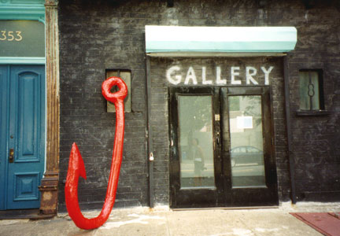
Considering joint response efforts

Slide 3
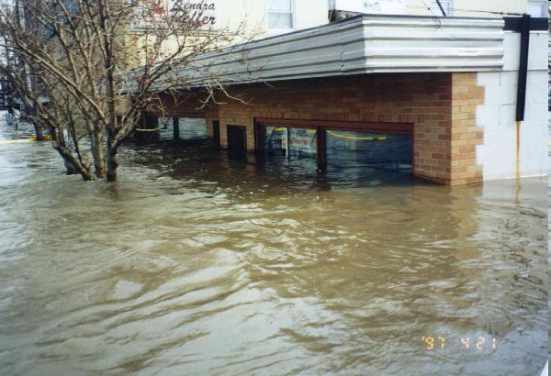

Slide 4
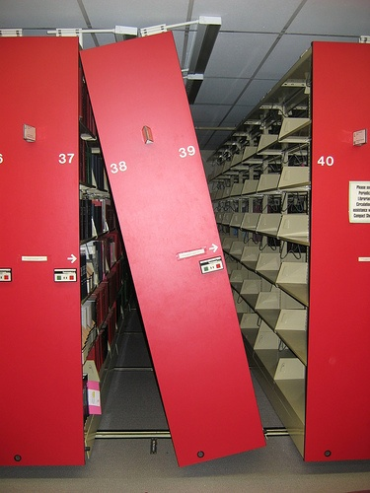

Slide 5
Cooperative Disaster Planning
Saving Money
Resource Utilization
Service Resumption Issues
Group Education and Information
Insurance Issues
Recovery Planning
Technical Issues
Alliance for Response Toolkit: http://www.heritageemergency.org/initiatives/alliance-for-response/tool-kit-3-2/

Slide 6
Saving Money Through Cooperative Planning
Group Training and Consulting
Central Supply Caches
Consortial Contracts with Recovery Vendors
Consortial Insurance Contracts

Slide 7
Better Resource Utilization
Greater Number of Trained Responders
Familiarity with Institutions in Consortia
Utilizing Strengths of Each Staff
Larger Community Volunteer Base

Slide 8
Service Resumption Issues
Reciprocal Borrowing
Computer Hot Sites
Interlibrary Loan Fulfillment
Donation Processing Centers

Slide 9
Group Education and Information
Shared Disaster Plans
Shared Building/Floor Plans
Familiarizing Staff and Physical Plant
Baseline Preparedness, Response, and Recovery Training
Annual Disaster Plan Update/Practice
Recovery Vendor Presentations

Slide 10
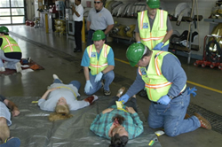
Education
Show & Tell
Speakers & Events
Group Training
Tabletop exercises
Community Wide Simulations

Slide 11
Possible Training Sessions
First Aid
Service Resumption Issues
Insurance
Recovery Techniques
Incident Command Structure

Slide 12
Insurance Issues
Consortial Policies and Buying Power
Collection Valuation
Identification of High-Probability Risks

Slide 13
Recovery Planning
Local Efforts
The First 48 Hours
Business Resumption
Long-Term Recovery

Slide 14
Technical Issues
Review of Safety Systems
Archiving of Digital Data and Electronic Resources/Records
Computer Hot Sites

Slide 15
Mutual Aid Agreements
Written Document
Defines Response
Administration Support
Exit Clause

Slide 16
Memorandum of Agreement Info
SILDRN
Member participation
Member fees to pay for supplies
Disaster assistance

Slide 17
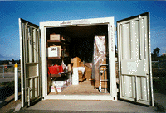
Supply Caches
Centralized Supplies for an Individual Institution or for Joint Use in a Regional Disaster
Supplies for Your Agency
Disaster Response Supplies

Slide 18
Mutual Aid Agreement Models
San Diego (SILDRN): https://sites.google.com/site/sildrn/sildrn/mutual-aid-agreement-1
Savannah/Atlanta (SHER/HERA): http://www.heritageemergency.org/wp-content/uploads/2014/06/SHERN-Mutual-Aid-Agreement-2.pdf
Seattle (SHERN): http://www.heritagepreservation.org/AfR/Seattle/News.html

Slide 19
Philadelphia Alliance for Response
Began with large Forum in June 2007
Strong “buy-in” from Office of Emergency Management, Fire Chief, & Commissioner of Records
OEM modified their Business Planning and Response workshops specifically for cultural institutions
Text-alert system grows from 11 cultural institution representatives to over 100
OEM working to locate cultural institutions on City GPS system
Credentialing for site re-entry is a future project

Slide 20
Pittsburgh Alliance for Response
Began in June 2008; initial Forum meeting had strong corporate and community support
Regular elections for Chair and Committee Heads
Strong focus on education:
Tabletop exercises
Insurance, Mold Remediation presentations
Half-day workshop on Fire Protection Systems
Institutional site visits with survey report outcomes
Winterizing Your Collections discussion*
Received NEH Preservation Assistance Grant to develop cooperative disaster supply cache

Slide 21
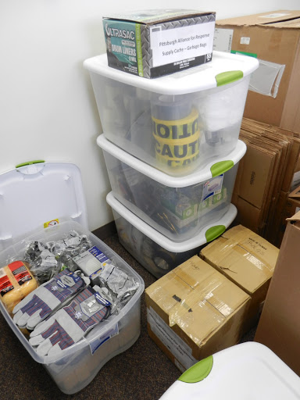
Pittsburgh AFR: Collaborative Use of PAG Funds

Slide 22
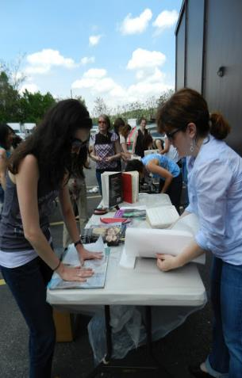
Pittsburgh AFR Disaster Recovery Workshop

Slide 23
Setting Up Your Network
Who to include?
Define your area
What is already happening in your area?
Who to invite to the table?

Slide 24
How do you get others involved?
Recruit
Part of the job description
Allow for training opportunities

Slide 25
Places to Start
Form a leadership committee
Define your mission
Get everyone working on their own institutional (and individual) preparedness
Communication pathways

Slide 26
Cooperative Disaster Planning – Needs
Point Person at Each Institution
Sharing of Disaster Plans
Consulting and Training Activities
Central Supply Cache – Identify Host
Consortial Vendor & Insurance Contracts

Slide 27
Cooperative Action Steps
Review of Plans and Risks
Disaster Assessment Surveys – Buildings, Collections, Staff & Patrons
Consortial/Joint Plan
Preparedness, Response, and Recovery Training Models
Establish Response Team

Slide 28
Cooperative Action Steps, cont.
Recovery Vendor Presentations
Insurance Issue Discussions
Develop Technical Response
Mutual Aid Agreement
Meet 2-3 times annually?

Slide 29
Funding for Your Network
Response Network
Supply Cache
Disaster Response

Slide 30
Funding Sources
Dues?
Outside Sources:
NEH
FEMA
IMLS/LSTA
NCPTT
NEA/Arts Councils
NHPRC/SHRAB
Private Funders

Slide 31
A Grant to Assist in Planning
National Endowment for the Humanities – Preservation Assistance Grants
Up to $6,000 for preservation consulting, education, and supplies/equipment
Preservation Site Survey projects including Disaster Risk Assessments and Disaster Plan Development; Pittsburgh used funding for Disaster Cache
2016 Deadline: May 3 (early May each year)
Information at www.neh.gov

Slide 32
Sustaining your network
Rotate responsibility
Set limits for positions
Require representation from
each participating agency
Make it interesting!

Slide 33
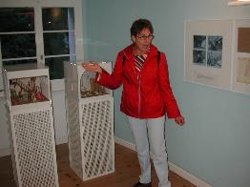
Activities to sustain your network
Meet at Supply Cache
Training for Members
Recruitment tool
PR mechanism
Site Visits
Happy Hour

Slide 34
Resources for Disaster Preparedness
Foundation of the American Institute for the Conservation of Historic and Artistic Works (AFR and NHR): http://www.conservation-us.org/emergencies -- Jessica Unger, junger@conservation-us.org, 202-661-8069
Heritage Emergency National Task Force: Lori Foley, Administrator, FEMA/Smithsonian, lori.foley@fema.dhs.gov, 202.826.6303
LYRASIS: 800.999.8558 or www.lyrasis.org
CCAHA: 215.545.0613 or www.ccaha.org
NEDCC: 978.470.1010 or www.nedcc.org

Slide 35
Questions or Comments?
please contact us for more info.
Phone 614-439-1796
Email tom.clareson@lyrasis.org
Tom Clareson
Sr. Consultant for Digital & Preservation Services

