Slide 1
Tabletop Exercises
By
Allen Evans
Training & Compliance Coordinator
Virginia Museum of Fine Arts

Slide 2
What are Tabletop Exercises?

Slide 3
Tabletop Exercises
Discussion-based exercises where personnel meet in a classroom setting or in breakout groups to discuss their roles during an emergency and their responses to a particular emergency situation. A facilitator presents a scenario and asks the exercise participants questions related to this scenario, initiating discussion among the participants about roles, responsibilities, coordination, and decision-making.

Slide 4
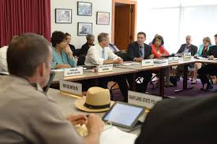
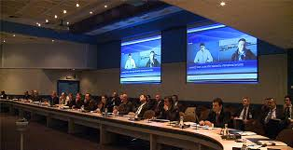
Tabletop Exercises
Are discussion-based only and do not involve deploying equipment or other resources.

Slide 5
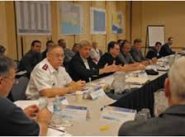
Tabletop Exercises are designed to
Help an organization test a hypothetical situation
Evaluate a specific group’s ability and readiness to work together and respond to an emergency

Slide 6
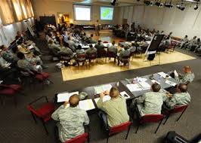
Major Elements of a Tabletop Exercise
Evaluation of plans and procedures by policy-level personnel.
Resolution of questions regarding coordinating responsibilities
Facilitation of group discussion.

Slide 7
Why involve Policy-Level Personnel?
They are responsible for running the organization.
They are the ones who will take the heat from the media when an incident goes bad because of poor planning or lack of planning in regards to an emergency action or a continuity of operations plan.

Slide 8
Advantages of Tabletop Exercises
Low stress environment
Low cost
Ongoing evaluation
Facilitates group discussion of problem areas

Slide 9
Ground Rules
Recommended directions for your tabletop exercise:
This is intended to be an open, low-stress environment, not a test. Varying viewpoints, even disagreements, are expected and encouraged.
This type of exercise is the ideal setting for considering different approaches and suggesting improvements to current resources, plans, and training.
Responses should be based on current capabilities.
Fight the problems, not the scenario.
Respect the speaker.
Use the open issue list for any item that is not directly related to the discussion at hand.
Avoid “bar discussions.”
No beeps, buzzes, or ringtones. Turn off and put away all personal electronics.
Start on time, end on time, and use timers to divide up tasks.
Look through the windshield and not the rear view mirror.
Enough, Let’s Move On (E.L.M.O.)
No coming and going—you can come or you can go; but you can’t come and go.
There are no “hidden agendas” or trick questions intended to mislead participants.
All participants receive the same information at the same time.

Slide 10
Purpose of Tabletop Exercises
Primarily meant to invoke discussion.
Guided by one or two facilitators (with shared responsibilities).
Participants solve problems as a group.
Consists of real – life situations.
Keep it simple. No elaborate facilities or communications.
One or two evaluators may be selected to observe proceedings and evaluate progress towards objectives.
Success depends upon feedback from participants. Feedback may lead to revision of polices, plans and procedures.

Slide 11
Goals of Tabletop Exercises
Test the plan:
Does it work?
Does it have the information users need?
Is it realistic?
Identify weaknesses and determine how the plan can be improved to circumvent these and become more complete.

Slide 12
Common Exercise Mistakes
Scenarios that are not tailored to the local area or unique organization
Scenarios that are too complex to manage successfully with available resources
Allocating inadequate time for exercise play
Failing to provide a constructive critique of the exercise afterwards
Not addressing safety issues properly
Exercises that are planned and initiated too quickly
Excluding critical agencies that should be included
Failing to implement “after–action items”

Slide 13
Result of a Tabletop Exercise
Can result in action plans for continued improvement of either an emergency action or a COOP plan.
An after-action report is generated, identifying weaknesses or creating new ideas to make improvements or strengthen plans.

Slide 14
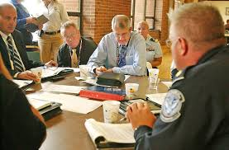
Key Factors for Tabletop Exercises
Exercise Development
Exercise Participants
Scenario Development

Slide 15
When should you plan to develop your Tabletop Exercise?

Slide 16
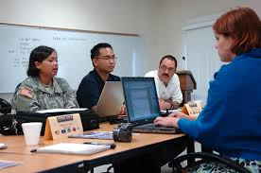
Tabletop Exercise Development
You should plan on development of your tabletop exercise at least 3 months prior to presentation.

Slide 17
How often should you conduct testing of your Tabletop Exercise?
State executive branch agencies must conduct annual testing of plans, under Executive order # 41 signed by former Governor Bob McDonnell . Most agencies will use tabletop exercises as part of the testing procedures.
All organizations should try to conduct a tabletop exercise at least twice a year. One to test your emergency action plan and the other to test your continuity of operations plan.

Slide 18
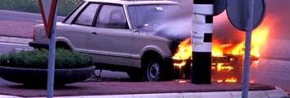
Exercise Plan Development
Keep it simple and straightforward!
Don’t make the scenario too big and too complicated
Take the time to Prepare!

Slide 19
Exercise Plan Development
Encourage internal participants to bring any material related to the scenario, such as copies of either an emergency action plan or the COOP plan.
It is a judgement call as to whether or not you wish to tell participants about the scenario before the exercise.

Slide 20
Tabletop Exercise Room and Setup
Large room and/or multiple rooms needed (can be done at remote locations)
Provide tables for agencies, table agency signs, and nametags, if needed
For large exercises, a microphone at the command post table is recommended for notifying all participants of key developments and decisions
Audio / visual aids add realism

Slide 21
Time Frame
At the beginning of each session, clearly define the number of hours participants have to work on each session as well as how much time passes in ‘exercise time’ compared to ‘real time’.

Slide 22
Facilitators
A key element of successful tabletop exercises
Encourage all participants to contribute to the discussion, and to remind them that they are dealing with hypothetical situations in a no-fault environment.
Facilitators also build and maintain an environment where all the participants feel comfortable speaking honestly and where differences of opinion are respected.
Help to ensure that everyone feels included in the conversation and has an opportunity to participate.
Facilitators are not there to lecture or dominate the discussion, but rather to keep conversations moving.

Slide 23
Characteristics of Good Facilitators
Keep discussions on track and within established time limits.
Control group dynamics and strong personalities.
Speak competently and confidently about the subject without dominating the conversation.
Have subject-matter expertise or experience.
Are aware of localized plans and procedures.
Capture key findings and discussion points during the exercise.

Slide 24
Things for Facilitators to Remember
On an administrative note, facilitators should discourage side conversations, ensure cellular phones are turned off or made silent, and control group dynamics.
During the exercise, facilitators need constantly to be aware of time constraints, notifying participants about progress and letting them know when time is running short.

Slide 25
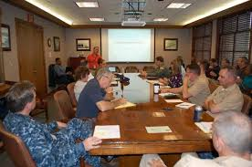
Exercise Participants
Never have an exercise before making sure that people are trained re: plan, process and the roles and responsibilities

Slide 26
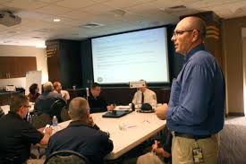
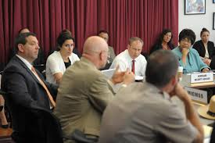
Exercise Participants
Make sure you include the right people in the room – have those involved who can make the appropriate decisions (inputs should reflect the right level – e.g., middle managers – middle management decisions).

Slide 27
Team Leaders
Your team leader should be the agency head or someone who is authorized per your agency regulations to act in that position if the agency head is not available.
Make sure you identify the team leader at the beginning of the exercise.

Slide 28
Outside Exercise Participants
Reasons
Outside Partners Identified
Serve as subject matter experts (Depending upon the scenario)
Offer resources to the agency.
Establishe working partnerships.
Bring credibility to the tabletop exercise.
Law Enforcement Representatives
Emergency Medical Services
Fire and Rescue
Hospitals
Local or State Emergency Managers
Local Health Departments
School Districts
Volunteer and Faith-Based Organizations
Utility Managers, especially your local electricity provider
Generator Supplier or Manufacturer
Transportation Provider
Sister Facilities
Management Company

Slide 29
Exercise Evaluators
Use two evaluators.
Recommended that exercise evaluators are brought in from outside and are not internal.
Outside evaluators can provide better input without showing favoritism or bias.
However, please try to select evaluators who possess experience with tabletop exercises.

Slide 30
Scenario Development
Determine the scope
Is this a tabletop for:
•your business (single site)?
•multi-site?
•industry-wide?
•with partners?

Slide 31
Scenario Development
Make sure the scenario has a positive outcome.
No need to be “Pollyanna” – but the scenario should demonstrate improvement.

Slide 32
Hot Wash
Marks the transition from actual exercise play to the evaluation phase where lessons are learned and corrective actions documented.
It is important to conduct the hot wash at the end of the exercise while all participants are still present and the day’s discussions are still fresh in their minds.

Slide 33
After-Action Report
A professional discussion of an event, focused on performance standards in an action plan, that enables the group to discover for themselves what happened, why it happened, and how to sustain strengths and improve on weaknesses.

Slide 34
Evaluation forms from the team
Important to get feedback from the team on:
How was the exercise?
Was it planned and organized properly?
Did the exercise meet their needs as far as preparedness?
What lessons were learned from the exercise?
Would you participate in another exercise?

Slide 35
After-Action Report Sections Handling Instructions
Title of Document
Whether the document is classified or not and how it should be handled and/or disseminated.
Points of contact

Slide 36
After-Action Report Sections
Executive Summary
This section should provide a general overview of the goals, purpose and objectives of the exercise. For smaller activities such as seminars and drills, the capability analysis and/or conclusion may be included here.
Exercise Overview
Information in this section should clearly identify the specific exercise. Data should include the exercise name, date(s), location(s), and participating local governmental and non-governmental agencies, mutual-aid jurisdictions, state and federal partners.
Scenario
Provide a complete description of the narrative, major or key updates, and injects that drove player action to accomplish the objectives. In most cases, the Master Scenario Events List (MSEL) does not need to be submitted. The scenario may be presented as a separate section, as part of the executive summary or in the exercise overview.

Slide 37
After-Action Report Sections
Capability Analysis
Identify the Core Capabilities that were tested and evaluated in the exercise. Provide a description of the objectives within each capability, the observations, any discussion or analysis, and the outcomes. Recommendations are often included in this section. Seminars and workshops may include a brief analysis in the Executive Summary or Conclusion sections.
Conclusion
The conclusion should provide a general review of the exercise, its overall outcome and potential improvements. For small exercises, this may be included in the Executive Summary.
Acronyms
Acronyms specific to your community or plans should be defined for readers not familiar with your community.
Improvement plan
Recommendation/Improvement/Corrective Action responsible agency and office estimated completion date.

Slide 38
After-Action Reports
Keep them simple
Stay on topic
Keep them brief

Slide 39
Finally
Take time to plan your tabletop exercise properly. Don’t just throw something together and expect the group to participate.
The more effort you put into planning and organizing your exercise, the better it will be appreciated by your participants and it will be worth its weight in gold.

Slide 40
Questions

Slide 41
References
IS-120.A: An Introduction to Exercises
https://training.fema.gov/is/courseoverview.aspx?code=IS-120.a
IS-547.A: Introduction to Continuity of Operations
https://training.fema.gov/is/courseoverview.aspx?code=IS-547.a
IS-550: Continuity Exercise Design Course
https://training.fema.gov/is/courseoverview.aspx?code=IS-550
Planning a tabletop exercise by Laurie Pearce & Don Bindon
www.epicc.org

Slide 42
Contact Information
Allen Evans
Training & Compliance Coordinator
Virginia Museum of Fine Arts
200 North Blvd
Richmond, Virginia 23220
Office: 804-340-1412
Cell: 804-514-4175
Email: allen.evans@vmfa.museum

